Slide 1
Parallel Computing
Ekkapot Charoenwanit
Software Systems Engineering
TGGS
KMUTNB

Slide 2
Lecture 7:
Shared-Memory Programming with OpenMP
Functional Parallelism
Synchronization Constructs
Thread-Local Storage

Slide 3
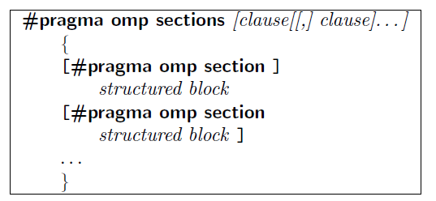
OpenMP: Sections Construct
The sections construct provides functional parallelism by enabling different threads to carry out different tasks:
It permits us to specify several different code regions, each of which is represented by a section construct and is executed by one thread in the team.
It consists of two different directives as follows:

Slide 4
OpenMP: Sections Construct
The code block of each section must be a structured block, i.e. one entry and one exit.
At runtime, one thread executes one section at a time, and one section will be executed exactly once.
If there are fewer threads than sections, some or all threads must execute multiple sections.
If there are more threads than sections, the remaining threads will be idle.

Slide 5
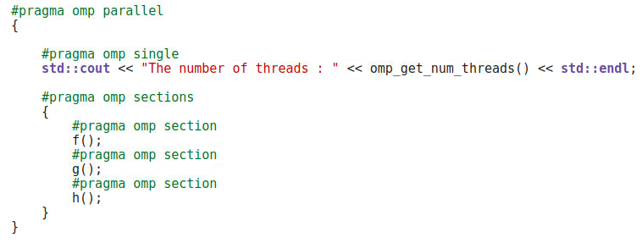
OpenMP: Sections Construct
If three or more threads are available, one thread might invoke f(), a second one might invoke g() and a third one might invoke h() whereas the remaining are idle, waiting at the implicit barrier.

Slide 6
OpenMP: Synchronization
Recall that we need to:
synchronize actions on shared variables
ensure the correct ordering of reads and write to shared variables
protect concurrent updates to shared variables
Updates to variables are not atomic by default.

Slide 7

OpenMP: Barrier Construct
The OpenMP directive used to implement an explicit barrier in OpenMP is
No threads cannot progress past a barrier construct until all threads in the team have arrived.
The all-or-none Principle !!!
Either all threads in the same team or none must encounter a barrier.
Otherwise, this will result in a deadlock.
This is one of the very few OpenMP directives that do not have an associated block of code.

Slide 8

OpenMP: Critical Section
In OpenMP, a critical section can be denoted by the critical section construct which provides a means to ensure that multiple threads do not attempt to update shared data simultaneously.
An optional name can be given to a critical construct and this name is global.
When a thread encounters a critical section, it waits until no thread is executing inside the critical section with the same name.

Slide 9
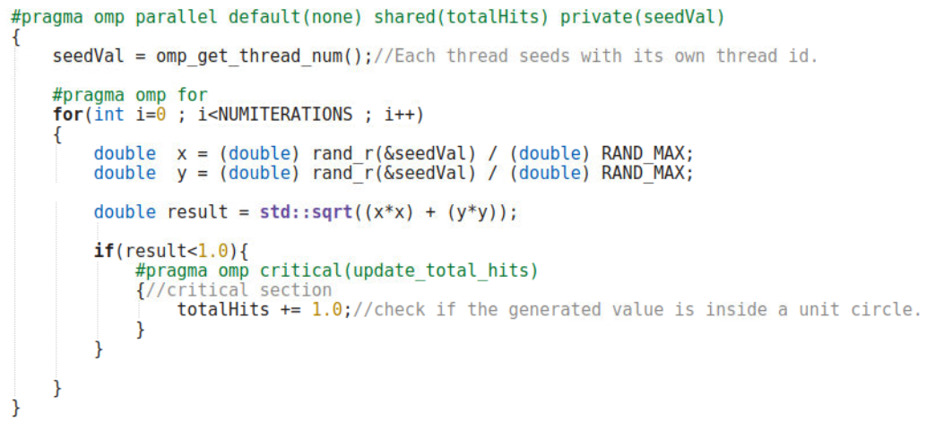
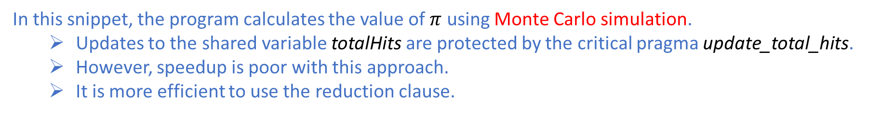
OpenMP: Critical Section
In this snippet, the program calculates the value of $π$ using Monte Carlo simulation.
Updates to the shared variable totalHits are protected by the critical pragma update_total_hits.
However, speedup is poor with this approach.
It is more efficient to use the reduction clause.

Slide 10

OpenMP: Atomic Construct
The atomic directive is used to protect a single update to a shared variable:
It applies to only a single statement, instead of a code block.
The syntax of the atomic directive is
where statement is a single arithmetic statement.

Slide 11
OpenMP: Single Construct
The single construct is a work-sharing construct that specifies that the associated code block should be executed by one thread only.
There is always an implicit barrier at the end.
The other threads wait at the barrier until the code block has been executed by the chosen thread.
The implicit barrier at the end of the construct can be removed with the nowait clause.
The syntax of the single directive is

Slide 12
OpenMP: Single Construct
It is up to the OpenMP runtime which thread in the team to execute the code associated with a single construct.
This construct can be useful when:
if one thread in the team is an I/O thread.
there is a setup part such as memory allocation and deallocation where only one thread must be responsible for.

Slide 13
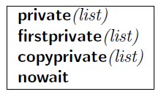
OpenMP: Single Construct
Clauses supported by the single construct

Slide 14
OpenMP: CopyPrivate
The copyprivate clause provides a mechanism for broadcasting the value of a private variable from one thread to the other threads in the team:
The typical use for this clause is to have one thread initialize or read private data that is subsequently used by the other threads as well.
After the single construct has ended, but before the threads have left the associated barrier, the values of the private variables specified by the copyprivate clause are copied to the other threads.
The standard prohibits the use of this clause in combination with the nowait clause.

Slide 15
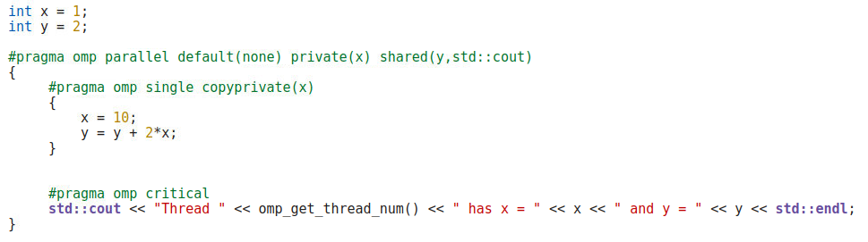
OpenMP: CopyPrivate

Slide 16

OpenMP: Master Construct
The master construct is a synchronization construct.
The syntax of the master directive.
Only the master thread in the team executes the associated code block.
It differs from the single construct in that there is no implicit barrier at the end.

Slide 17
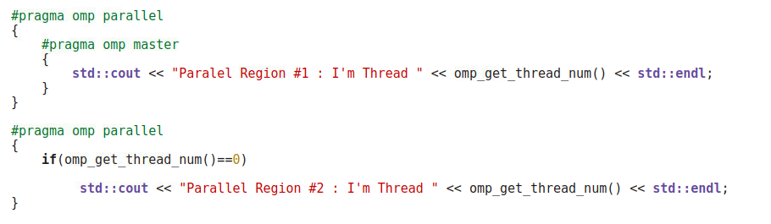
OpenMP: Master Construct
The master construct can be implemented with an if-statement as shown in the code snippet above.

Slide 18
OpenMP: ThreadPrivate Clause
By default, global data is shared.
However, in some situations, we may need or would prefer to have private data that persists throughout the computation.
This is where the threadprivate clause comes in handy.
The effect of the threadprivate clause is that the named global-lifetime objects are replicated so that each thread has its own copy.

Slide 19

OpenMP: ThreadPrivate Clause
That is, each threads gets a private or a local copy of the specified global variables.
The syntax is
Restriction is that
The dynamic threads mechanism must be turned off with omp_set_dynamic(false) so that the number of threads across different parallel regions remains constant.

Slide 20
OpenMP: Nested Parallelism
If a thread in a team executing a parallel region encounters another parallel region, it creates a new team and becomes the master thread of that new team.
This is generally referred to in OpenMP as “nested parallelism”.
By default, this feature is disabled, meaning that the thread that encounters a nested parallel region will not form a new team, i.e., the encountered parallel region is inactive.
The omp_get_nested() routine can be used to test if nested parallelism is enabled.

Slide 21
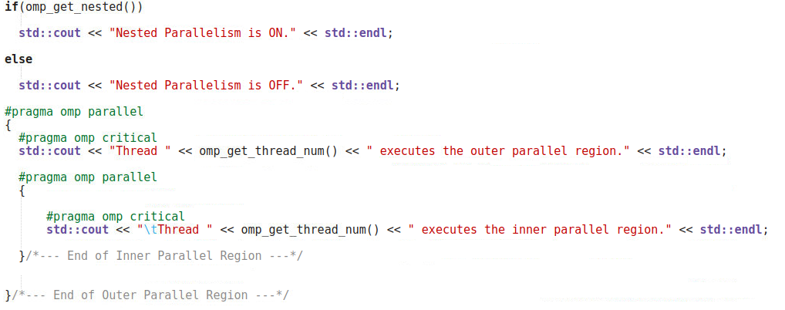
OpenMP: Nested Parallelism

Slide 22
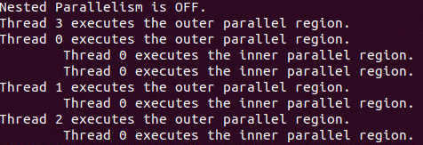
OpenMP: Nested Parallelism
Executing the code snippet on the previous slide might give you output that looks similar to the following output:
To enable nested parallelism, the OMP_NESTED environment variable needs to be set to true:
This OMP_NESTED environment variable is currently deprecated by the standard.
In a future version of OpenMP, you might need to use a different mechanism for enabling and disabling nested parallelism.

Slide 23
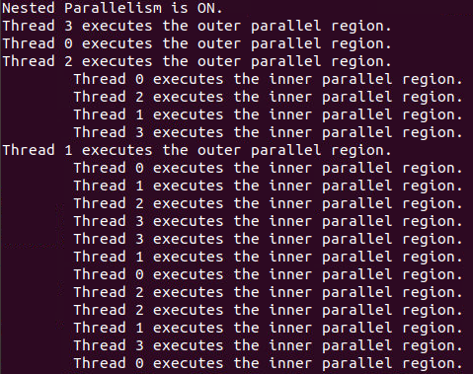
OpenMP: Nested Parallelism
After enabling nested parallelism by setting the OMP_NESTED environment variable to true.

Slide 24
OpenMP: Collapse Clause
A short loop (one with a small number of iterations) has a downside in a serial program:
The loop distribution overhead might dominate the performance if there is no sufficient work to do per loop iteration.
A short loop might not only limit the number of threads that may be used, but also leads to load imbalance if the number of iterations is not a multiple of the number of threads.
For perfectly nested rectangular loops, we can parallelize multiple loops in the loop nest using the collapse clause by mering or “collapsing” the multiple loops in the loop nest into one single and longer loop.

Slide 25
References
[1] Barbara Chapman, Gabriele Jost, and Ruud van der Pas. 2007. Using OpenMP: Portable Shared Memory Parallel Programming (Scientific and Engineering Computation). The MIT Press.
[2] Robit Chandra, Leonardo Dagum, Dave Kohr, Dror Maydan, Jeff McDonald, and Ramesh Menon. 2001. Parallel programming in OpenMP. Morgan Kaufmann Publishers Inc., San Francisco, CA, USA.

